Slide 1
陈 挺
Regularized Evolution for Image Classifier Architecture Search

Slide 2
Background
AutoML
Meta-Learning
Automated Data Clean, Data augmentation
Automated Feature Enginnering
Hyper-parameter Optimization
Neural Architecture Search
......
Notes:
Meta learning^{[1][2]} is a subfield of machine learning where automatic learning algorithms are applied on metadata about machine learning experiments.
learning to learn.

Slide 3
Background
Neural Architecture Search
Reinforce learning
ENAS
Evolution algorithm
Large-Scale Evolution of Image Classifiers Esteban(2017)
Regularized Evolution for Image Classifier Architecture Search, AAAI,2019 (2018)
Gradient based methods
DARTS
SNAS
……
Notes:
网络架构搜索，我们关注的网络的结构，例如一个CNN中，卷积多少层，filter size多大，pooling layer在那一层，等等。
而不是关注学习率，weight_decay等这些超参数。

Slide 4
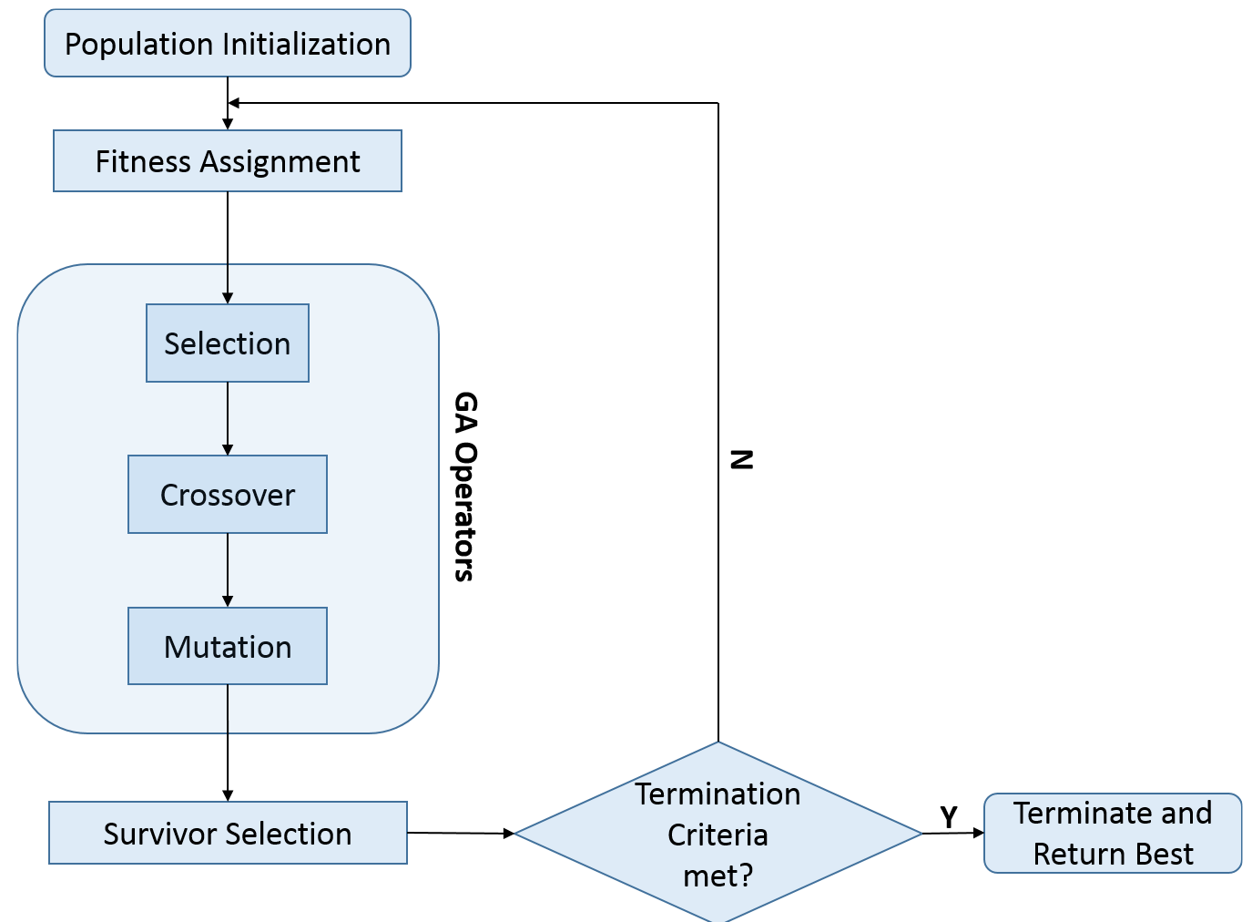
Background
Evolutionary(Genetic) algorithm
pic: https://www.google.com/url?sa=i&url=https%3A%2F%2Fsubscription.packtpub.com%2Fbook%2Fbig_data_and_business_intelligence%2F9781788472173%2F8%2Fch08lvl1sec60%2Fgenetic-algorithms-structure&psig=AOvVaw33Ln8zuSt1cCmw40LGy1-5&ust=1573727093345000&source=images&cd=vfe&ved=0CAIQjRxqFwoTCKjSlL_85uUCFQAAAAAdAAAAABAv
Evolution
vs
Random search ?
Notes:
遗传算法是一种通用的优化算法，

Slide 5
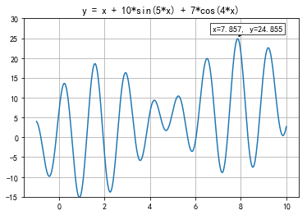
background
Evolutionary(Genetic) algorithm

Slide 6
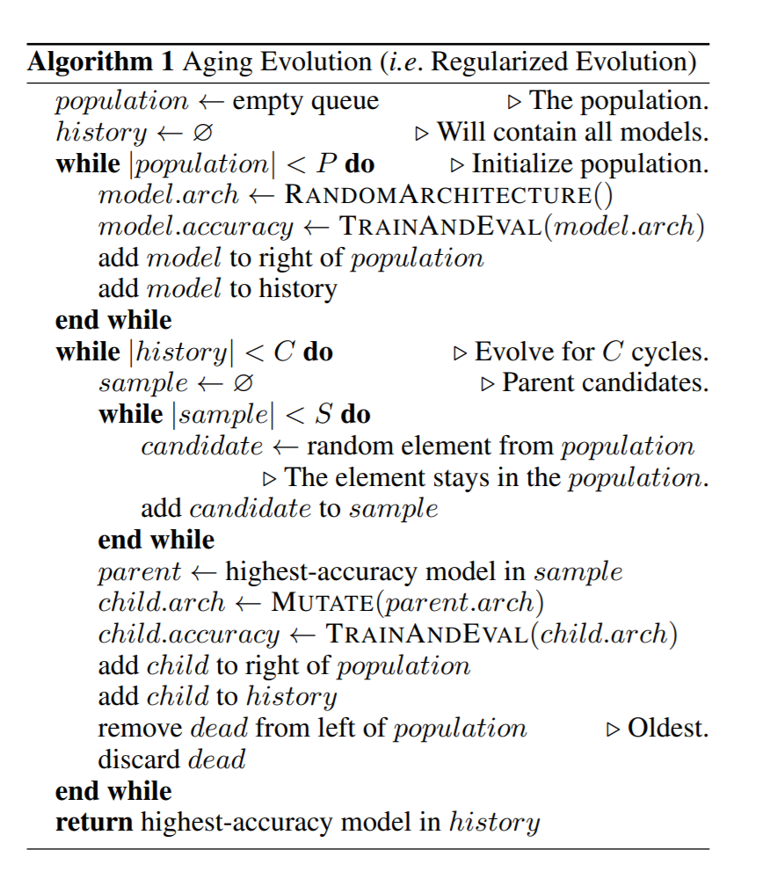
Algorithm
initialize population
selection
mutation(no crossover)
train & valid
update population
(ageing evolution)
Notes:
We will present evidence that the finite lifetimes of aging evolution can give better results than direct tournament selection, while retaining its efficiency
具体而言，
算法具体步骤如下随机初始化P个神经网络结构，将其加入到队列中，形成一个种群，
并进行训练对种群进行采样，选择S个神经网络采样得到S个神经网络，
选择其中准确率最高的神经网络作为父母
对其进行演化（变异）操作，获得新的神经网络结构，训练该网络，将其加入到种群中，
即队列的最右侧去除种群中年龄“最大”的神经网络，其实就是队列最左边的元素回到步骤二，循环一定次数该算法中的P、C、S的值自行指定Aging evolution算法模拟了自然界中的物种繁衍的操作自然界中，表现优异的个体往往更加容易留下后代。Aging evolution算法通过采样形成一个候选集，选择候选集中准确率最高的神经网络（表现最优异的个体）进行繁衍，以此模拟这个过程在自然界中，年轻的个体相比于年老的个体一般具有更好的潜能，更有可能留下后代。Aging evolution算法每次会去除种群中一个最老的个体，并加入一个新个体，以此模拟这个过程在自然界中，后代往往会遗传父母的一些特征，并在此基础上进行变异。Aging evolution算法选定一个神经网络，对该神经网络进行MUTATE操作，得到的新神经网络的结构既有与父母神经网络相同的部分（遗传），又有不同的部分（变异），以此模拟这个过程
————————————————
版权声明：本文为CSDN博主「菜到怀疑人生」的原创文章，遵循 CC 4.0 BY-SA 版权协议，转载请附上原文出处链接及本声明。
原文链接：https://blog.csdn.net/dhaiuda/article/details/93337707

Slide 7
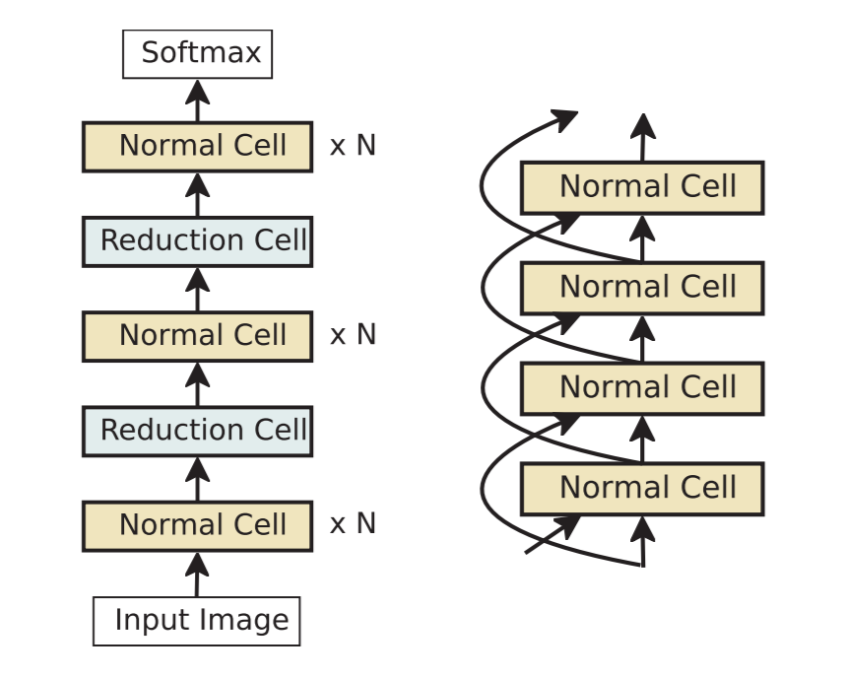
NASNet search space
CNN outer structure:
Normal Cell:
convolutional cells that return a feature map of the same dimension
Reduction Cell:
return a feature map where the feature map height and width is reduced by a factor of two
N：
hand design for specific task
F：
the number of filters of convolutions in the first stack
Zoph, Barret, et al. “Learning Transferable Architectures for Scalable Image Recognition.” CVPR, 2018.
Notes:
搜索空间：对应一个优化问题可能的解的范围，我们的算法应该在什么范围内去找解。。。
We use a common heuristic to double the number of filters in the output whenever the spatial activation size is reduced in order to maintain roughly constant hidden state dimension

Slide 8
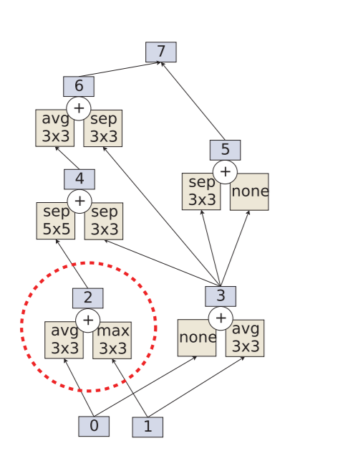
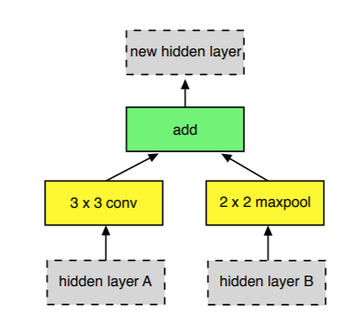
NASNet search space
CNN inner structure:
concat in depth
element-wise
*5
pairwise combination
feature map
Zoph, Barret, et al. “Learning Transferable Architectures for Scalable Image Recognition.” CVPR, 2018.
Notes:
Step 1. Select a hidden state from hi, hi−1 or from the set of hidden
states created in previous blocks.
Step 2. Select a second hidden state from the same options as in Step 1.
Step 3. Select an operation to apply to the hidden state selected in Step 1.
Step 4. Select an operation to apply to the hidden state selected in Step 2.
Step 5. Select a method to combine the outputs of Step 3 and 4 to create a new hidden state.
每个Cell其实由多组操作（op）组成，例如池化、卷积操作等，关于cell的例子可以查看右图，紫色方块表示隐藏状态，其实就是特征图。一个cell的构造过程如下：一个Cell一开始只有两个隐藏状态，即0和1，定义pairwise combination操作的次数随机选择两个隐藏状态，对这两个隐藏状态施加pairwise combination操作，从而得到新的隐藏状态重复步骤二，直到用完pairwise combination操作次数。
最后，所有未使用过的隐藏状态将concat在一起，例如图中的隐藏状态5和6

Slide 9
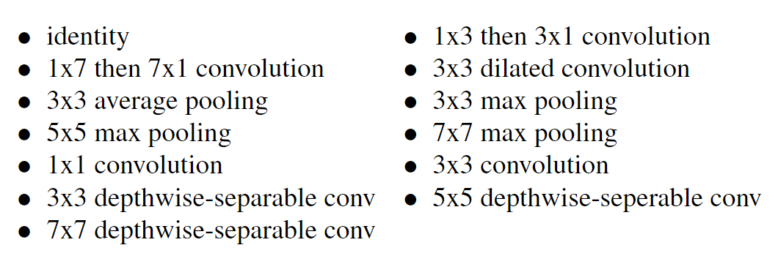
NASNet search space
CNN inner structure:
Zoph, Barret, et al. “Learning Transferable Architectures for Scalable Image Recognition.” CVPR, 2018.
Notes:
在两种cell之中我们有很多可选的操作，都是之前cnn骨干网络设计过程中的一些步骤。
No stride
depthwise-separable conv

Slide 10
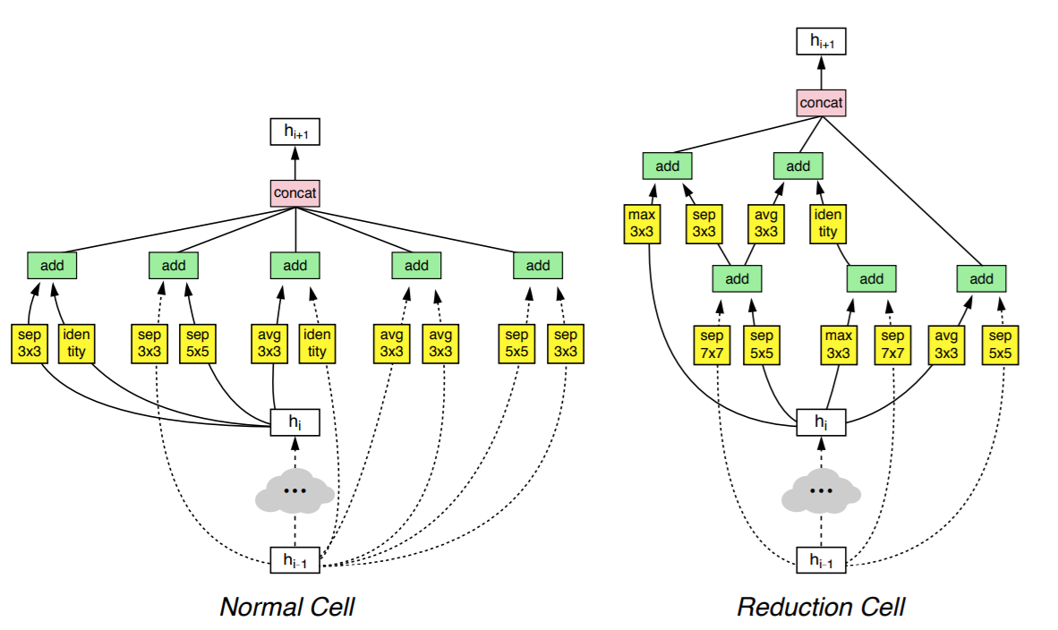
NASNet search space
CNN inner structure example:
Zoph, Barret, et al. “Learning Transferable Architectures for Scalable Image Recognition.” CVPR, 2018.

Slide 11
Search space
NASnet search space
Why limited search space ?
Restricted computing resource;
High experiment time;
….
Is normal&reduction cell effective ?
empirical rule…
like cnn backbone: inception-net, resnet…(stacking block, reducing feature map’s width&height while expanding depth)
Zoph, Barret, et al. “Learning Transferable Architectures for Scalable Image Recognition.” CVPR, 2018.
Notes:
该搜索空间固定了神经网络的总体结构，通过超参数N控制网络的深度，如中间的图所示，每个cell之间的连接采用残差结构，该搜索空间只搜索对应的Normal Cell与Reduction Cell的结构，企图找到最适合本任务的Normal Cell与Reduction Cell结构

Slide 12
Details of search space
All convolutions employ ReLU nonlinearity. Experiments with ELU nonlinearity [10] showed minimal benefit.
To ensure that the shapes always match in convolutional cells, 1x1 convolutions are inserted as necessary.
Unlike [24], all depthwise separable convolution do not employ Batch Normalization and/or a ReLU between the depthwise and pointwise operations.
All convolutions followed an ordering of ReLU, convolution operation and Batch Normalization following [21].
Whenever a separable convolution is selected as an operation by the model architecture, the separable convolution is applied twice to the hidden state. We found this empirically to improve overall performance.

Slide 13
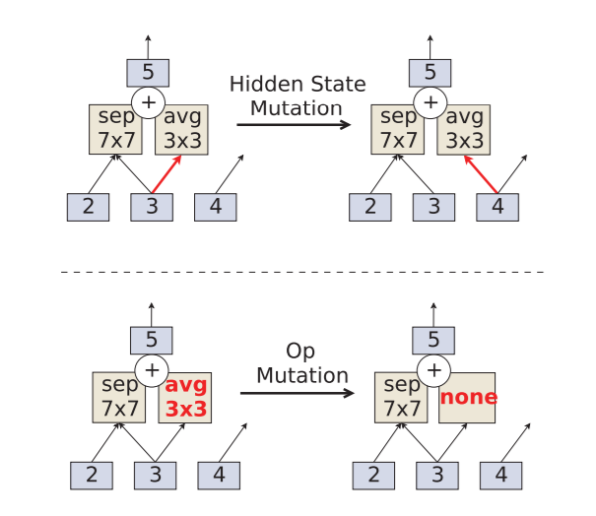
Detial
Mutation
Notes:
hidden state突变；
operations突变；

Slide 14
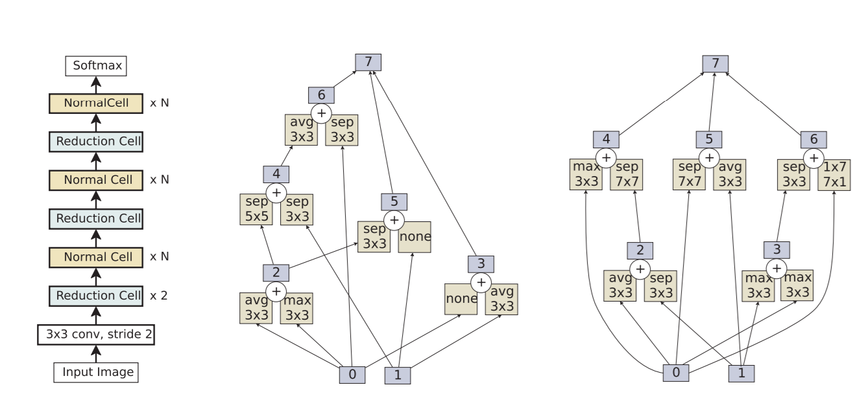
Result
AmoebaNet-A architecture
overall model
normal cell
reduction cell

Slide 15
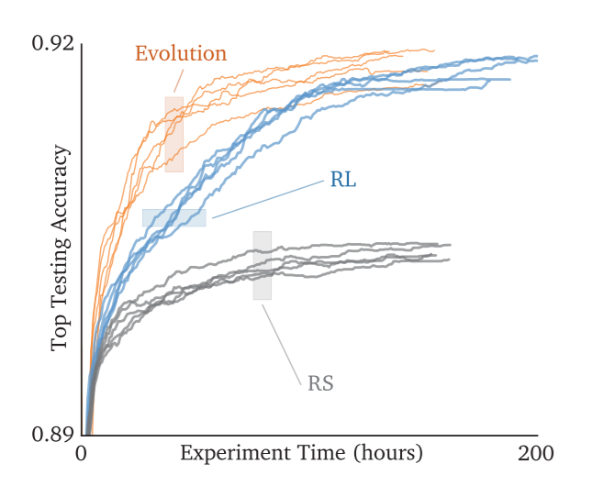
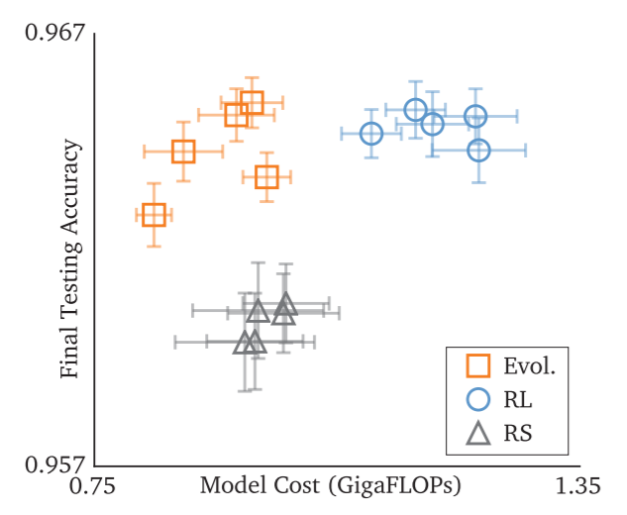
Result
Time costs
RL: reinforcement learning
RS: random search
Notes:
实验时间越长

Slide 16
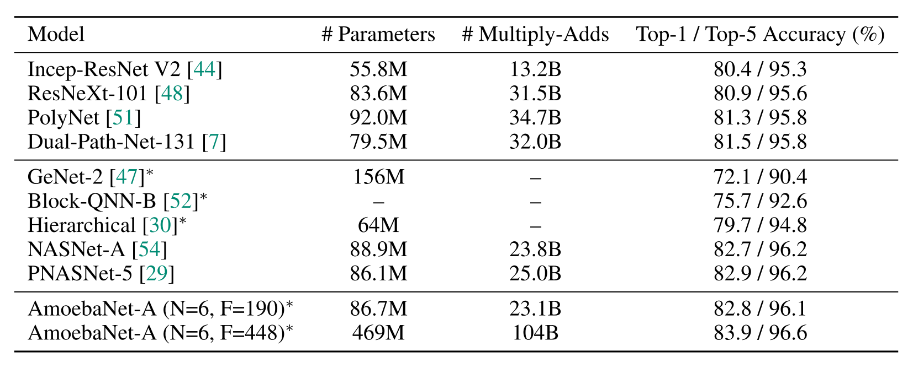
Result
ImageNet classification results

Slide 17
Reference
https://zhuanlan.zhihu.com/p/63932921

Slide 18
Paper detail
Unlike the generational algorithms, however, these discard models according to their performance or do not discard them at all, resulting in models that remain alive in the population for a long time—even for the whole experiment. We will present evidence that the finite lifetimes of aging evolution can give better results than direct tournament selection, while retaining its efficiency
propose to search foran architectural building block on a small dataset and thentransfer the block to a larger dataset
We achievethis transferrability by designing a search space (which wecall “the NASNet search space”) so that the complexity ofthe architecture is independent of the depth of the networkand the size of input images.
More concretely, all convolu-tional networks in our search space are composed of convo-lutional layers (or “cells”) with identical structure but dif-ferent weights. Searching for the best convolutional archi-tectures is therefore reduced to searching for the best cellstructure.
Searching for the best cell structure has two mainbenefits: it is much faster than searching for an entire net-work architecture and the cell itself is more likely to generalize to other problems.
keep a popula tion of N models and proceed in cycles: at each cycle, copy- mutate the best of S random models and kill the oldest in the population
The main contribution of this work is the design of anovel search space.
NASNet searchspace
They are com-posed of convolutional cells repeated many times whereeach convolutional cell has the same architecture, but dif-ferent weight
In random search, instead of samplingthe decisions from the softmax classifiers in the controllerRNN, we can sample the decisions from the uniform distri-bution
This result suggests that 1) the NASNet searchspace is well-constructed such that random search can per-form reasonably well and 2) random search is a difficultbaseline to beat.

Slide 19

Thank you!

